Slide 2
THE PROMISE
Genesis 12: 3… 18: 18, 22: 18, 26: 4, 28: 14, 35: 11 48: 19 → Jewish understanding throughout the OT
Revelation 7: 9 → Christian reality!
Psalm 22: 27 → The Messiah!

Slide 3
Daniel 2: 44 - 45
There was an anticipation for the Messiah to appear…
The Israelites were looking for a Messiah for a reason

Slide 4
SIGN OF JONAH

Slide 5
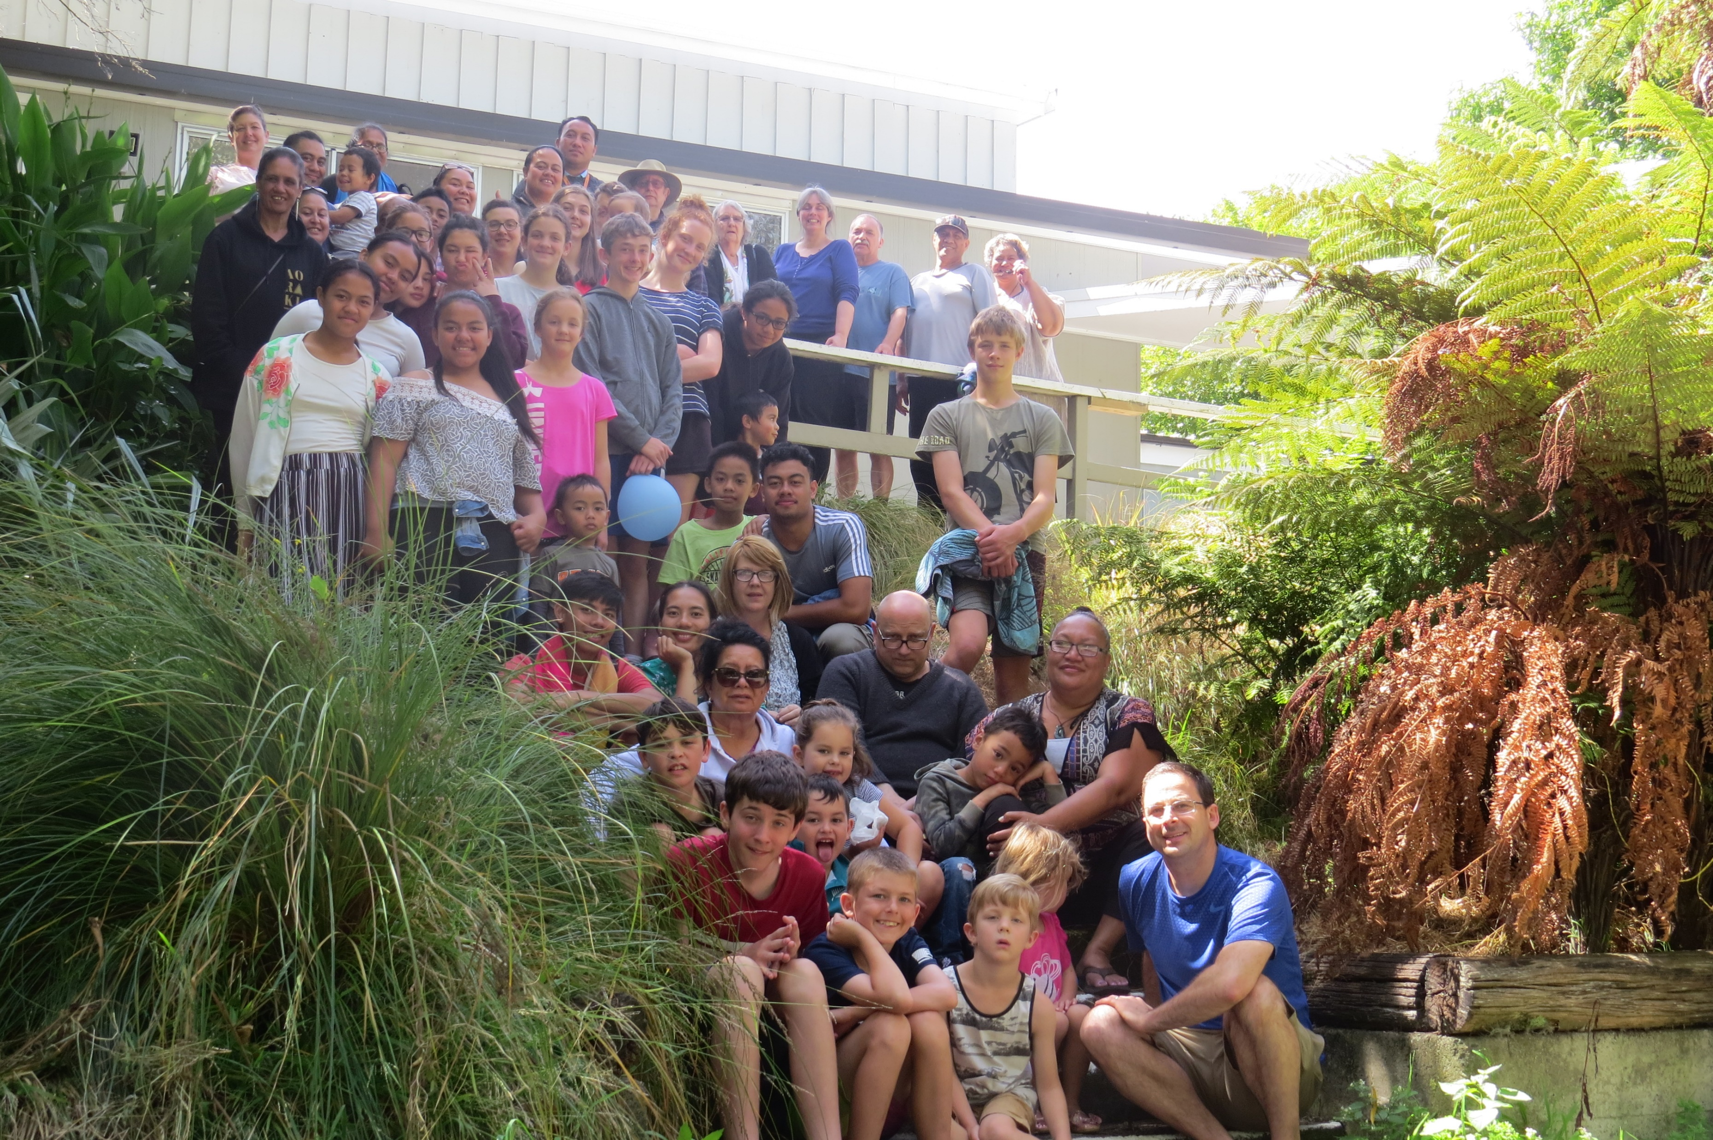
Valley Church

Slide 6
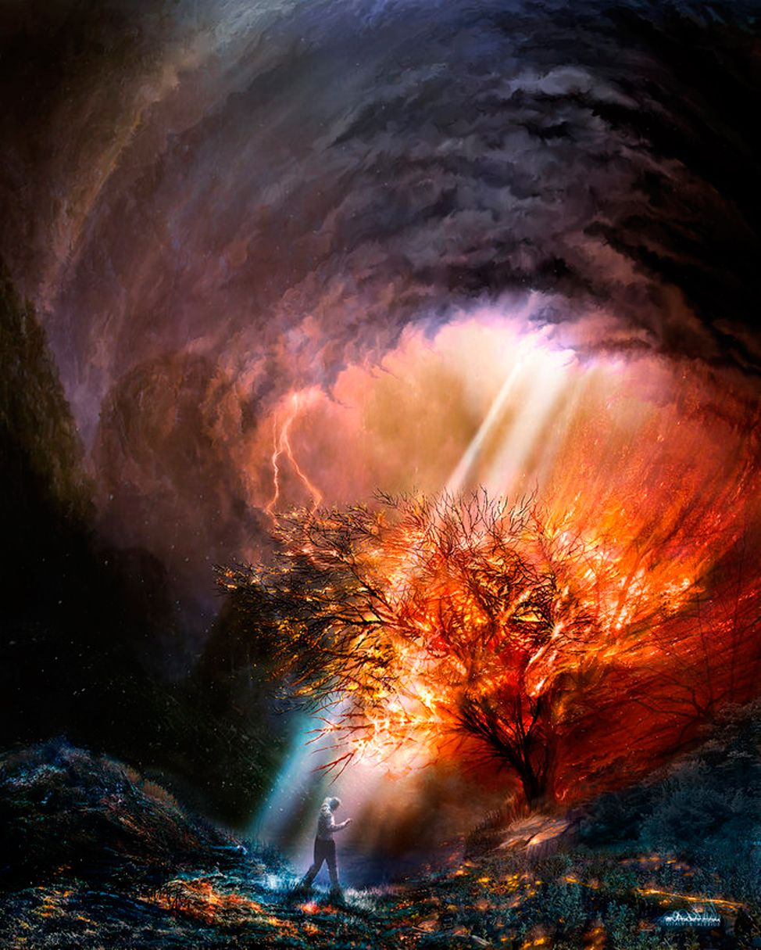
#INDISPUTABLE!
Facts that are unable to be challenged or denied
The discussion today is going to focus on the resurrection of Jesus from a different perspective yet deeply rooted in God’s Word.
God of Abraham, Isaac, and Jacob “I AM” Exodus 3:14
Jesus, who is the great “I AM,” not only proclaims this (John 8: 58) but like the burning bush further illuminates this for each of us
“I AM…
…the Bread of Life …the Light of the World …the Gate …the Good Shepherd …the Resurrection and the Life …the Way, the Truth, the Life …the True Vine

Slide 7
#OG!
The resurrection is the original claim of the first believers and of the Christian Church from the EARILIEST record!
Church… → the resurrection is the POWER
No doubt Jesus did some remarkable things, but the FUNDAMENTAL claim of the Church was not Jesus healer, feeder, water walker, or exorcists
IT WAS JESUS CRUCIFIED AND RESURRECTED!
Sadly, the debate and discussion surrounding Jesus will continue, but the position and claim of the earliest believers is #INDISPUTABLE
→ Jesus was crucified and on the third day resurrected!

Slide 8
#WORD on the Street
It is one thing for the folks “inside” of a group to adhere to a set of beliefs and to make those beliefs known. But there ARE many ACIENT reports that also detail the circumstances of Jesus’ death and even report the claim of resurrection.
According to NON-BELIEVERS Jesus lived, died, and His “followers” believed He had come back to life.¹
Along with these very ancient references (which exist) will be decades and centuries of unbelievers’ reporting, combating, persecuting, and interacting with Christians → #INDISPUTABLE

Slide 9
#BELIEVE IT!
Original martyrs don’t experience continued persecution or die for what they known is a lie
They LIVED and yes, died for what they actually experienced (Jesus Risen) and did so in such a way with such an influence that future generations would know and trust WHO they knew and trusted!
That the first believers TRULY believed that they saw, interacted with and were transformed by Jesus resurrected is →
#INDISPUTABLE

Slide 10
#Chur BRO
What would have to happen to you so that you believed that your SIBLING was the great “I AM” the God of the universe?
There is not a ton of information on James, but what we have, both in the Bible and from non-Christian sources, is telling
James was the “brother” of Jesus and from all accounts NOT a believer until…
1 Corinthians 15: 7
This conversion is very well documented
Biblically → Leader
Martyrdom from outside sources
Jesus’ skeptical family believed He was “I AM” is # INDISPUTABLE

Slide 11
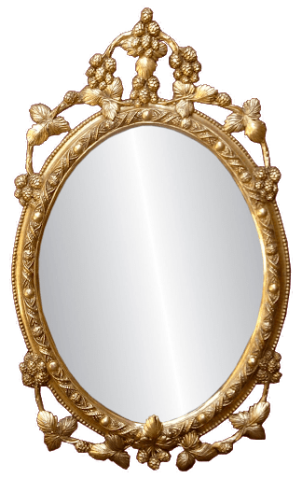
#indisputABLE
There are some other VERY compelling realities that are for the most part settled, but do have a small proportion of doubters/skeptics
Empty Tomb…
Jerusalem birthplace of the Church
Legend or embellishment are not a good explanation with the unflattering record preserved
2000 years of “foretold” reframed human history
Don’t you ever forget…
“If Jesus really rose from the dead, it reorders everything. Just like falling in love, it changes our view of the world.”²
John 8:59 is truly sad… BUT

Slide 12
#SO WHAT
Isaiah 6: 8…
Confronted with the risen Jesus, with the power of restoration… “What say you?”
Complete surrender to and transformation by the Risen Jesus is the ONLY explanation for the apostle Paul
Paul, then called by his Hebrew name Saul, a true religious Jew and persecutor of the believers was confronted by the risen Jesus.
Acts 26 apologia is very interesting
Former way of life → NOW
Like Isaiah… NES!
Paul’s radical transformation, influence on HISTORY, and foundational Christian mission/teaching are #INDISPUTABLE

Slide 13
“What say you?”
The “sing of Jonah” speaks directly to us
The great “I AM” is not welcome in the temple built of stone yet on the third day laid the foundation and built a temple not made with human hands!
God’s love, His unwavering fulfilled PROMISE of forgiveness and restoration will be seen in a very specific way
Paul teaches this amid division and turmoil…
How is the modern church viewed? How are you and I viewed?
Circle back to the question I asked a few weeks back… Do you believe that God can do something in you and through you that you CANNOT do for yourself?
When we see God creating, redeeming, building something new and beautiful in us; we have a HOPE for a lost and dark world that does not need our judgment…
but desperately desires the renewal and redemption of the forgiveness of sin and the peace and purpose of God’s LOVE

Slide 14
References
1) The Case for the Resurrection, Habermas and Licona
2) http://www.veritas.org/evidence-easter-scientists-list/

